Slide 1
Group meeting report

Slide 2
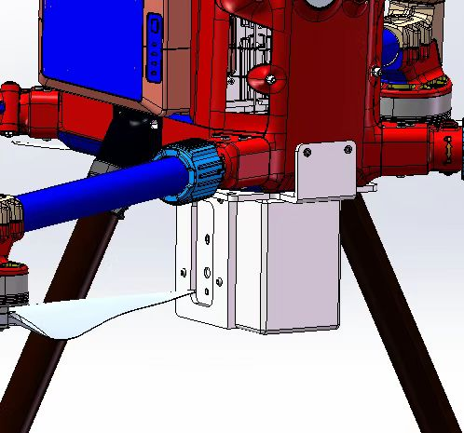
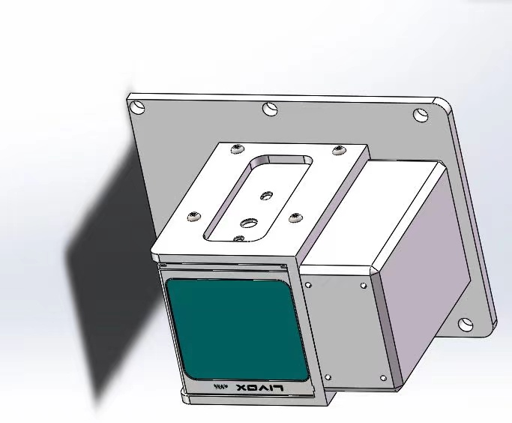
Hardware section-Connector

Slide 3
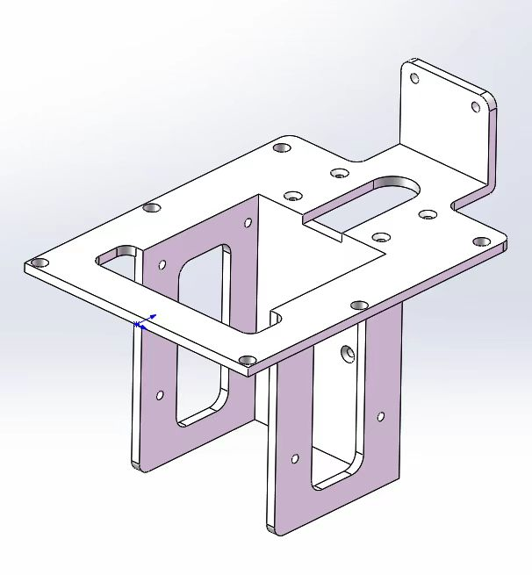
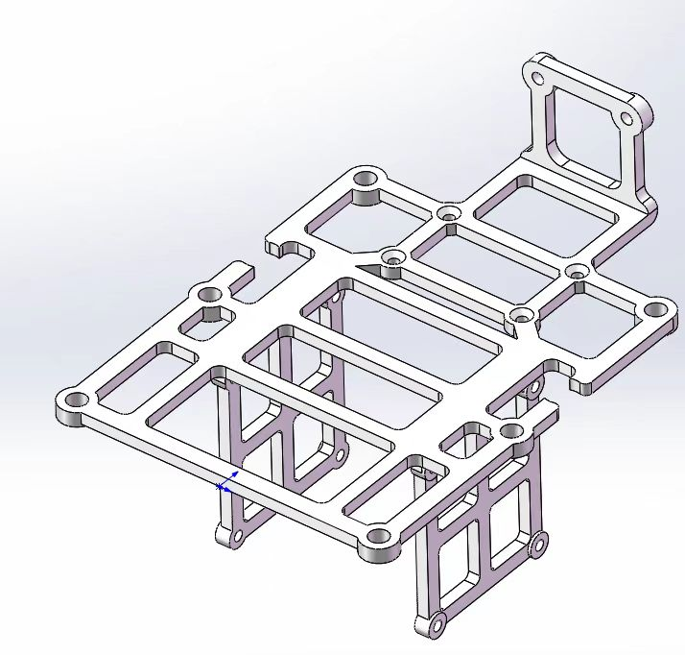
Hardware section-Connector
3 iterations
Step1:
Step2:

Slide 4
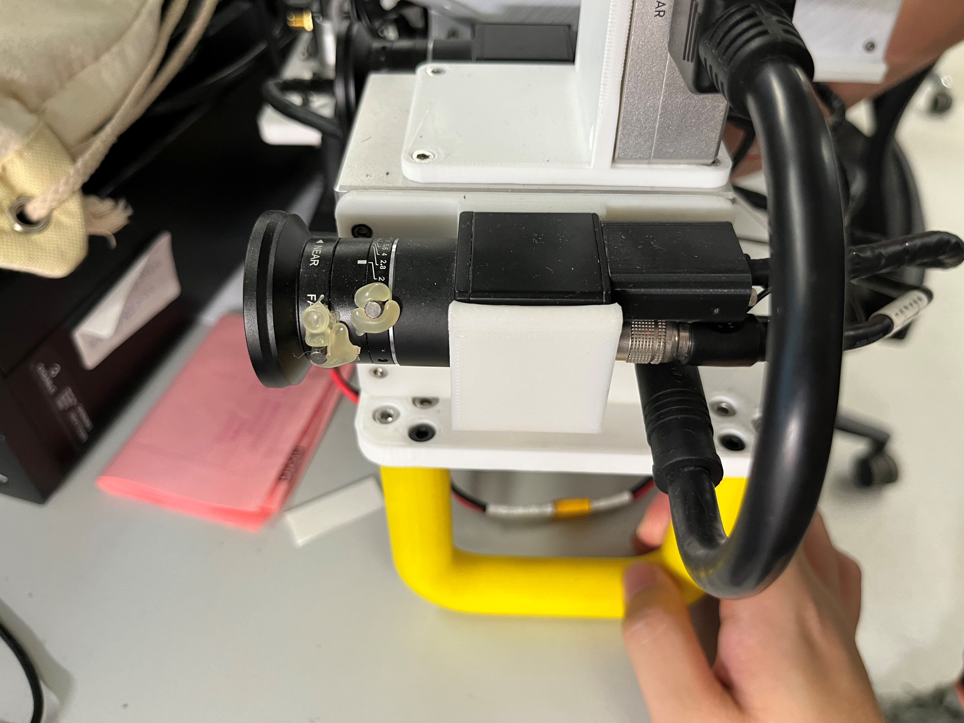
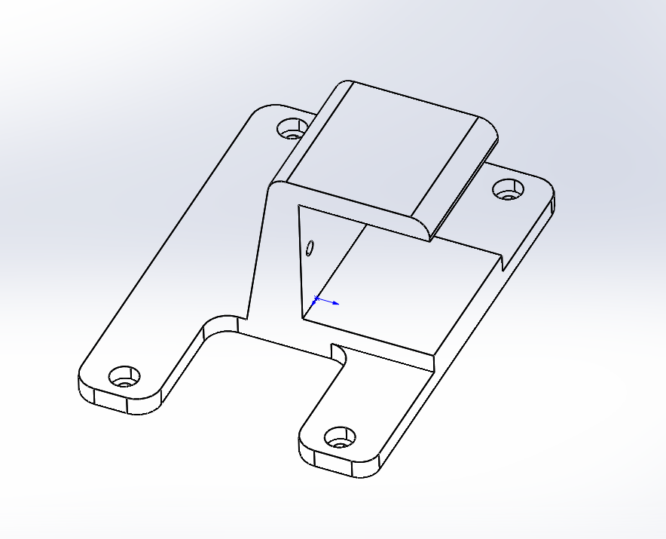
Hardware section-Connector
Add camera section

Slide 5
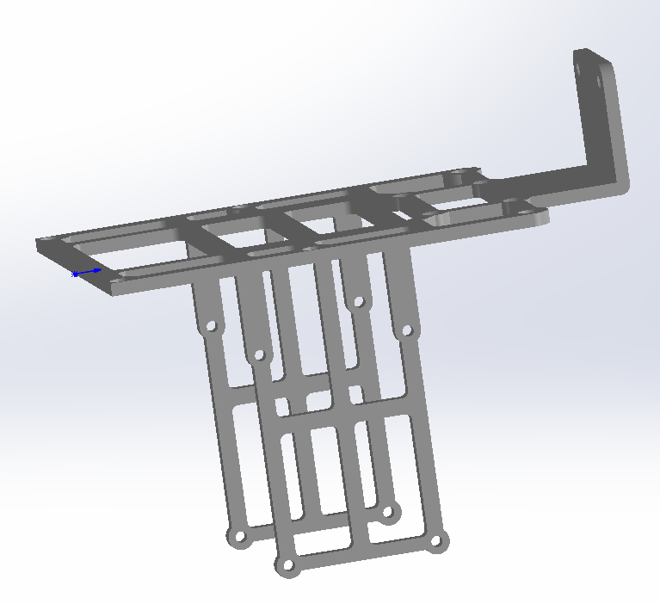
Hardware section-Connector
3 iterations
Step3:

Slide 6
Software section
Configuring the development environment on Manifold2
Install DJI Onboard SDK

Slide 7
Plan
跑通ROS例程
外场带设备试飞M300
跑fast-lio-gps

